Slide 1
Notes:
Teacher Materials: Training Workbook https://sandyhookpromise.box.com/s/7gb57hncm47fnsw7fjlzyv90iw2um3n6
Created by Sandy Hook Promise, our Say Something program teaches you how to keep your friends and classmates safe from hurting themselves or someone else in three easy-to-remember steps.

Slide 2
Learn the three steps that will help keep your friends and classmates safe from hurting themselves or someone else.
Understand what the Say Something program is.
Notes:
Today we have two goals:
Learn what the Say Something program
Learn three steps that will help you keep your friends and classmates safe from hurting themselves or someone else.
I'd like to add a special note to your teachers. Please remind students to have their Say Something Student Training Workbook with them, as well as a pencil and a pair of scissors, with them for the presentation, as I'll be asking your students to draw or write some things down. If available, each student should receive a small plastic bag to place their vocabulary cards in.
Teachers, the student activity packet with handouts is being dropped to you in the chat box if you haven't received it yet.

Slide 3
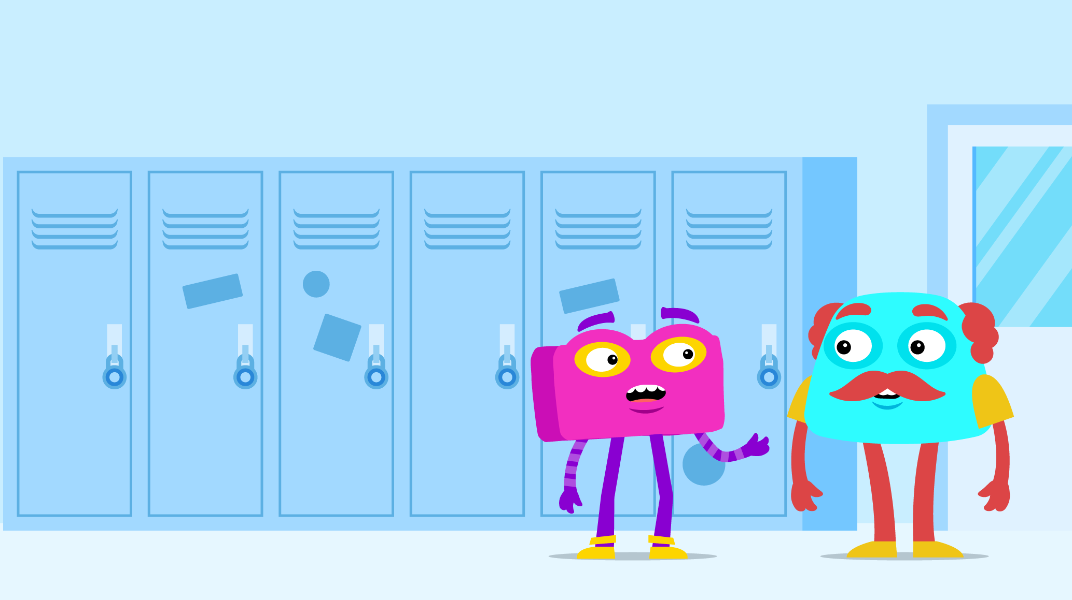
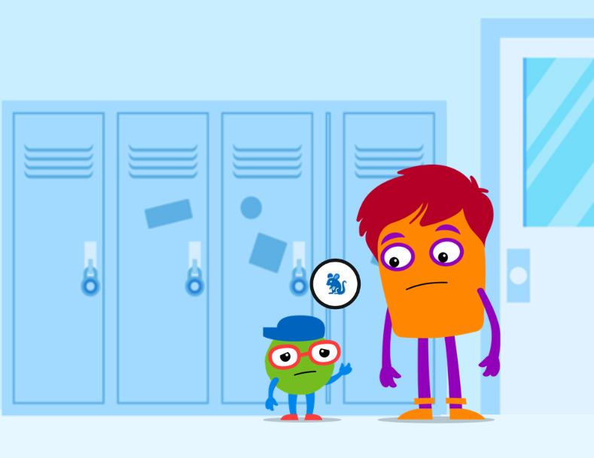
Vocabulary Bank
Say Something
"Saying Something" is when you are telling an adult an elephant-sized problem to get someone OUT of trouble or harm (large problem).
Snitching
Snitching is when you are telling an adult a mouse-sized problem to get someone in trouble (small problem).
Notes:
Before we start, I want first to review a few words you will be learning today.
The first word is the name of our program – Say Something! What does it mean to "say something"? Saying something means that you are telling a Trusted Adult a BIG problem to get someone out of trouble or harm.
The next word is Snitching. Snitching is different than "saying something". Snitching is when you are telling a Trusted Adult a SMALL problem to get someone else in trouble.
Sometimes, these two are hard to understand; the Say Something program will help you to understand these more today, and if you still feel confused, you can always ask a Trusted Adult for help!
This takes us to the next few words you will learn about today…

Slide 4
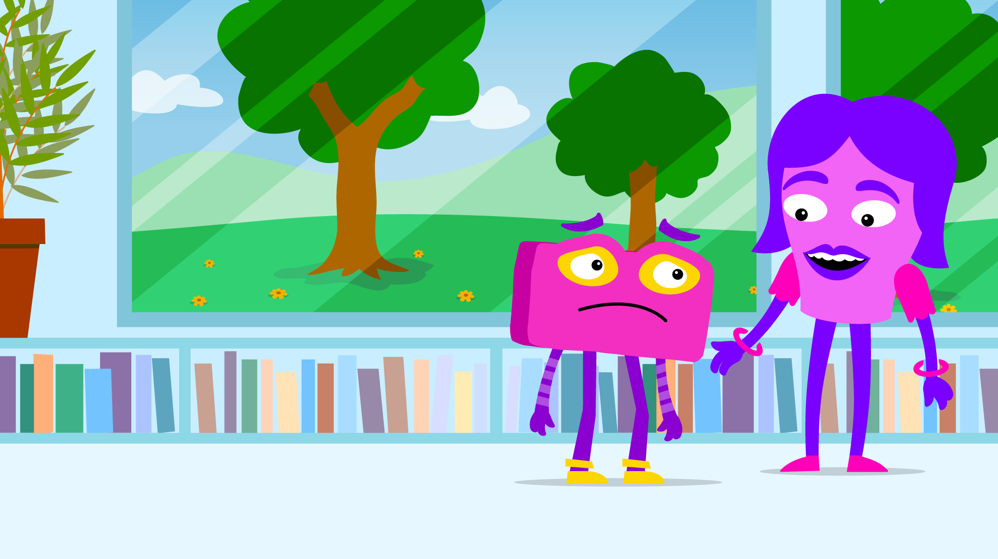
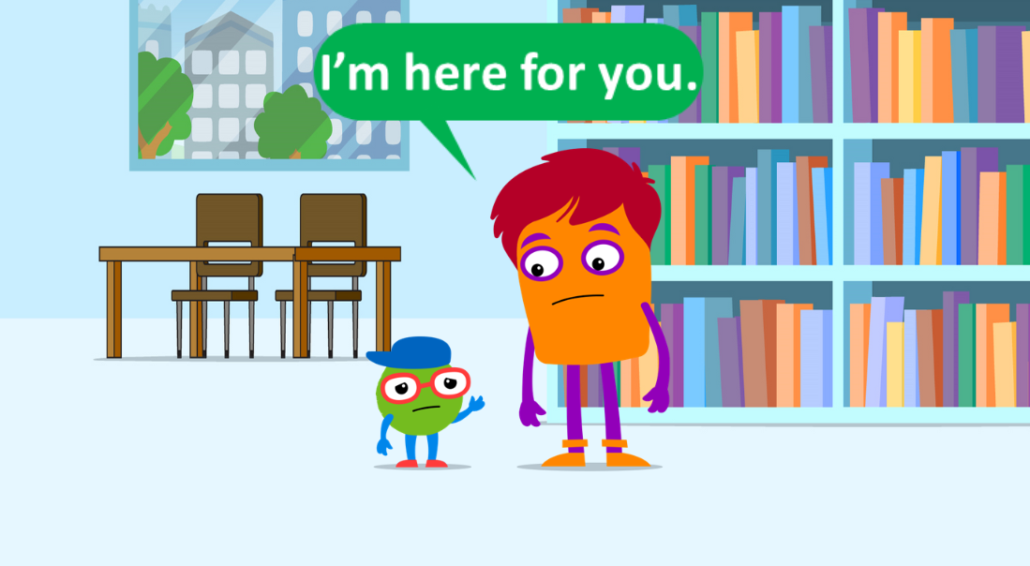
Vocabulary Bank
Upstander | Trusted Adult
An Upstander is someone who notices when things are not right and does something to help. Upstanders work to include everyone and to keep everyone safe. | A Trusted Adult is somebody over the age of 18 who can help you. If you notice something that is dangerous, a Trusted Adult can help you.
Notes:
As you learn about the Say Something Program, you will also here about Upstanders and Trusted Adults. These are two very kinds of important people in our program!
An Upstander is someone who sees that something is not right, and they speak up and "say something" about it. This can be like when you notice someone is making fun of your friend, and you tell them to stop or seek a teacher for help. When you do this, you are being an Upstander.
A Trusted Adult is an adult, over the age of 18, who is always there for you. This is an adult who you can go to if you notice something dangerous or you need help with something, for example, like telling a Trusted Adult that your friend is being bullied.
The next few words are words you will learn about in Step 1, let’s review them first.

Slide 5
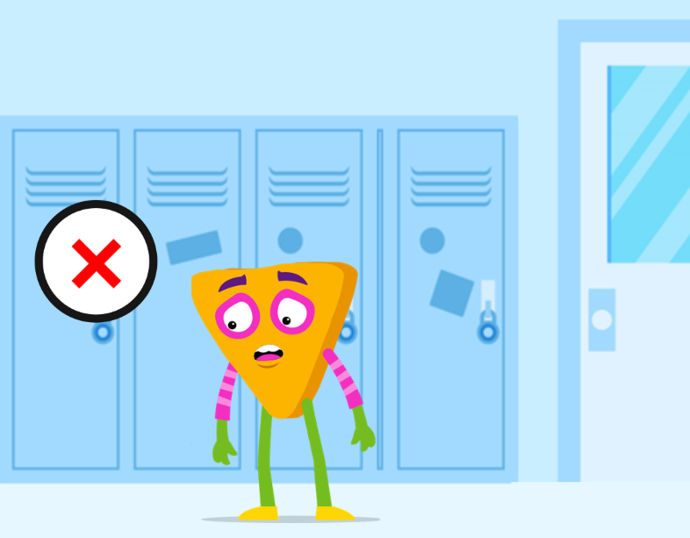
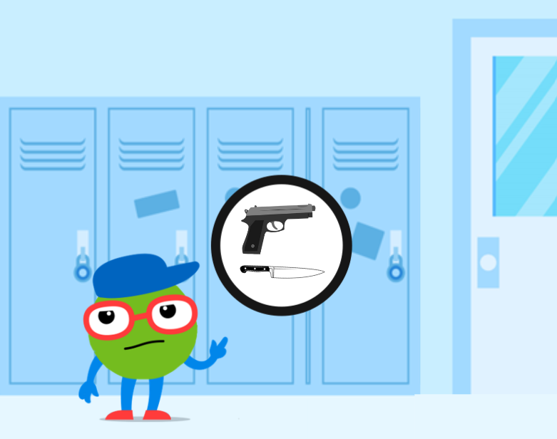
Vocabulary Bank
Warning Sign | Threat
A warning sign is a behavior that shows someone may be planning to hurt themselves or others. | A threat is when a person says that they DO plan to harm themselves or others.
Notes:
A warning sign is a behavior that shows someone MAY be planning to hurt themselves or others. We will go over examples of warning signs shortly.
A threat is when a person says that they DO plan to harm themselves or others.
Now that you know all of our vocabulary words, it’s time to learn about what the Say Something Program is!

Slide 6
Notes:
So… what is the Say Something program?
First, the Say Something program teaches you what warning signs and threats are. Once you understand what a warning sign and a threat are, the Say Something program gives you the power to notice and identify them.
It can be scary when you notice a warning sign or a threat for the first time. The Say Something program teaches you what to do when you feel like this.
So, what do you do?
The Say Something Program teaches you to act immediately and "say something" to a Trusted Adult! This means that as soon as you notice something, you act immediately. And what does act immediately look like?
The Say Something program shows us that acting immediately is when you seek a Trusted Adult to help you. Remember how I said being scared or worried about something is normal? The Say Something program helps you deal with these feelings by guiding you to find a Trusted Adult to help. Isn’t that great?
And with that… you may not have noticed it, but as I told you what the Say Something program is… you also already heard the three steps!
Let me show you them.

Slide 7
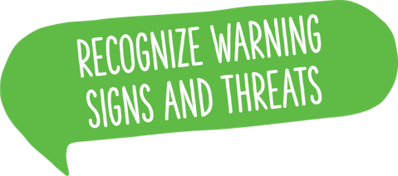
Notes:
Step 1: Recognize Warning signs and Threats.
Step 2: When you notice a warning sign or threat … Act Immediately and Take it Seriously
and Step 3: Say Something
Using these three steps, you will make a real difference in keeping your school safe and getting help for people who need it

Slide 8
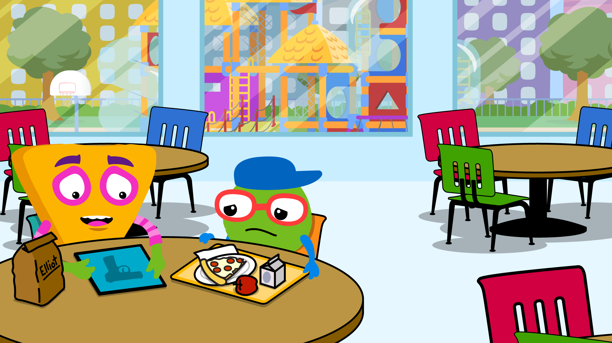
Warning sign: When someone says or does something that shows they MAY be planning to harm themselves or others
Threats: When someone shares that they DO have plans to harm themselves or others
Notes:
Now, let’s talk about each step a little bit more.
Remember when we learned what a Warning Sign and Threat were in the beginning? Let’s review them one more time!
Warning Sign: When someone says or does something, and you think they MAY be planning to hurt themselves or someone else.
Threat: When someone shares that, they DO have plans to hurt themselves or someone else.
Now you are ready for step 1: Recognize warning signs and threats, it’s important to remember that Warning Signs and Threats are not always something someone says. Sometimes people can write them or even post them online. Looking closely in this picture, you can see that Eliot has a photo of a gun and is smiling. In this situation, Eliot may not be saying he wants to harm anyone, but it is not normal behavior to be that fascinated by guns. This would then be a warning sign.
So now that we’ve identified one warning sign in this photo, let’s talk about some examples of warning signs and threats.

Slide 9
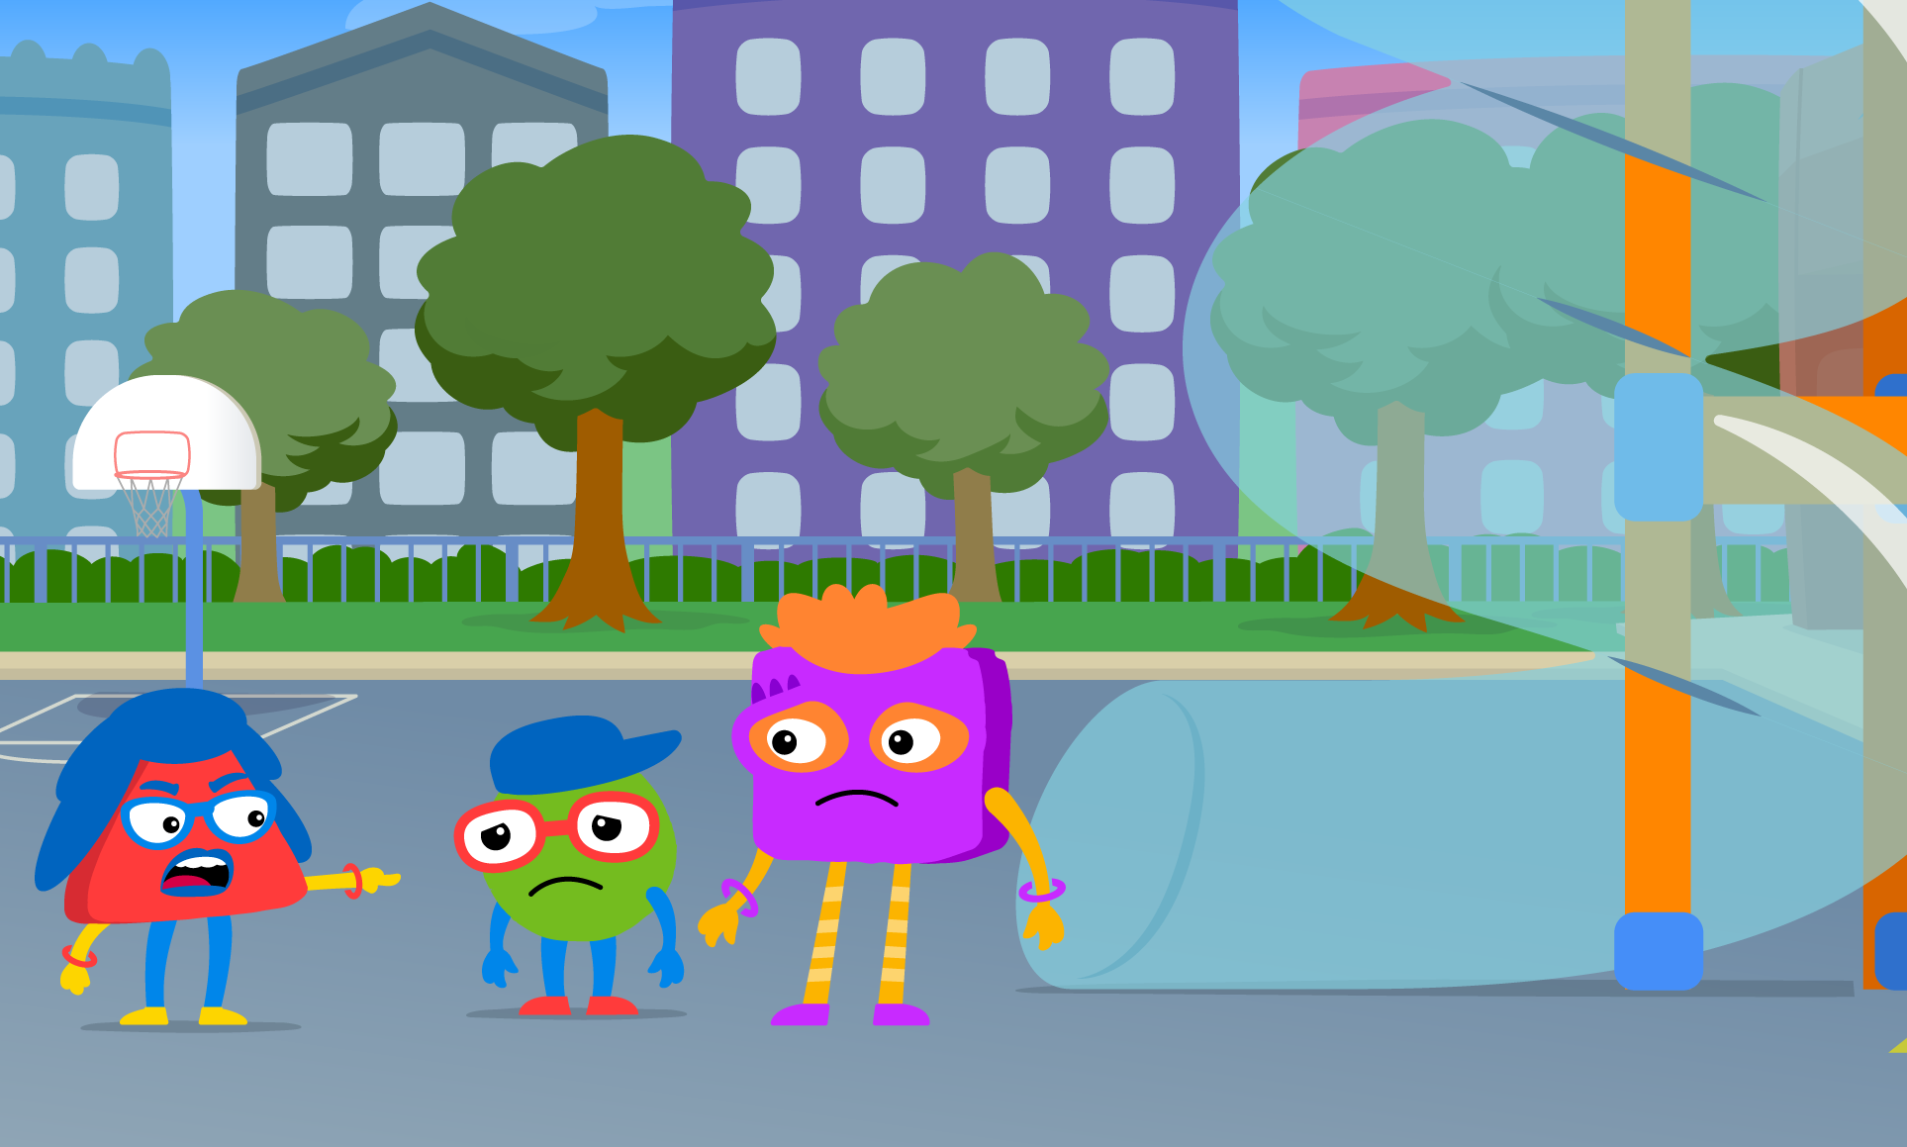
Talking about hurting others
Being bullied or bullying others
Saying or doing something that makes fun of others because they’re different
Hurting yourself on purpose
Big mood changes
Having access to a gun
Notes:
Here are some examples of warning signs.
Can anyone else share some examples they think could be Warning Signs?
Remember, a warning sign is when someone says or does something that makes you think they MAY be planning to hurt themselves or someone else. MAY is really important and helps you tell between a warning sign or threat.

Slide 10
“I’m going to hit him after school.”
“I think I’m going to hurt myself.”
“This school should be shot up.”
Notes:
Here are a few examples of what a threat could sound like.
Can anyone else share some examples they think could be threats?
Remember, a threat is when someone shares that they DO have plans to hurt themselves or someone else. DO is important because it means they already have made plans to hurt someone or themselves. This is what makes a threat different than a warning sign.

Slide 11
Warning Sign: When someone says or does something, and you think they ____ be planning to hurt themselves or someone else.
Threat: When someone shares that they ____ have plans to hurt themselves or someone else.
Notes:
Now that you learned about Step 1, help me fill in the blanks.
When you do this, I’ll know you’re ready to recognize Warning Signs and Threats.
Allow students some time to think before they answer. Read the statements to them without the missing word and allow them to think before raising their hand to answer. Encourage students to touch their heads when they are ready to fill in an answer. Call on volunteers to share or if students look confident as they touch their heads, encourage all the class to answer together.
Warning Sign: When someone says or does something, and you think they MAY be planning to hurt themselves or someone else.
Threat: When someone shares that, they DO have plans to hurt themselves or someone else.

Slide 12
When is it time to act?
When you notice a warning sign or threat.
How do I notice a Warning Sign or threat? You can use your senses: See, Hear, Feel.
You can also read a Warning Sign or Threat on a note, a drawing, or online.
Why might we not act?
“They’re just kidding.”
“I’m sure someone else already said something.”
“I don’t want to be a snitch.”
Notes:
Now, let’s talk about each step a little bit more.
Remember when we learned snitching and Say Something? Let’s review them one more time!
Say Something: Saying something means telling a Trusted Adult a BIG problem to get someone out of trouble or harm.
Snitching: When you are telling a Trusted Adult a SMALL problem to get someone else in trouble.
It’s important to remember that when you "say something" you are HELPING someone. Sometimes we are afraid to "say something" because we don’t want to be called a “snitch”. I’m here to tell you that safety will always come first. When you stand up for what is right, you are helping keep yourself and others safe.
Now that we have talked about what snitching and saying something means, Step 2 is to Act immediately and take it seriously.
When you do notice a warning sign or threat, it is important you do not forget. You should act immediately by finding a Trusted Adult. This means stopping what you are doing to tell them what you noticed.
When we learned about snitching, we heard that sometimes people are afraid to "say something" because they don’t want to be called a snitch. Remember that safety will always come first and your Trusted Adult will also help you with this.
Some other reasons people don’t say things immediately are because they think it is a joke or someone has already said something. Even if you think something is a joke, you should still act immediately. Remember, safety always comes first!
Repeat after me: SAFETY COMES FIRST.
Yes, exactly, safety comes first. That’s why even if you think it’s a joke, or if you think maybe someone already said something, safety comes first and you should still act immediately.

Slide 13
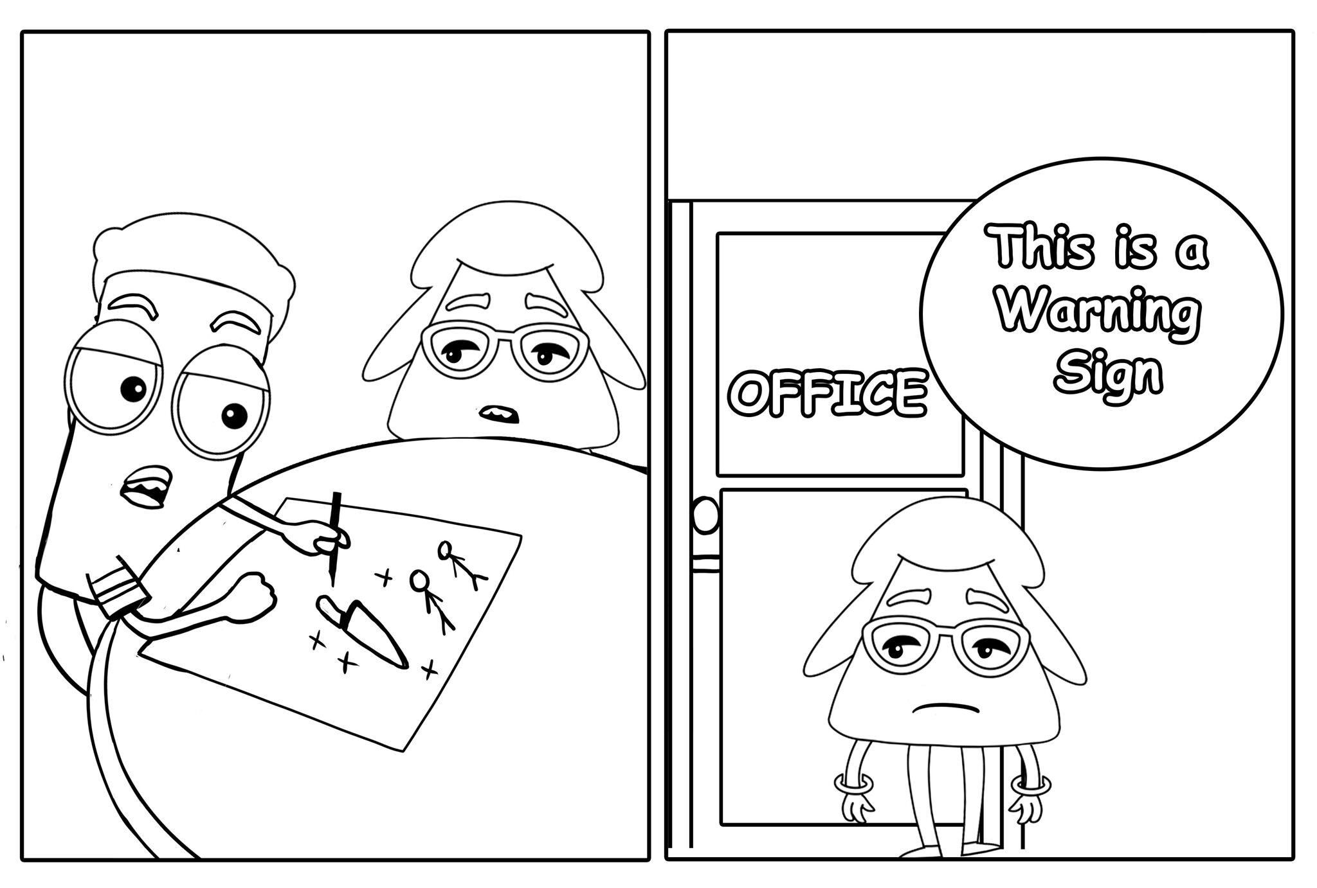
Notes:
Now, it’s time for you to see Step 2 in action.
What do you notice happening here?
Zoe is participating in Step 2, Act Immediately, Take it Seriously. Here, you can see that Zoe noticed Malik drawing a photo of him with a knife hurting somebody else. In this photo, Zoe is walking towards an office to tell a Trusted Adult.
You’re going to have some time to color these pages! Before you begin coloring, let's look at one more example...

Slide 14
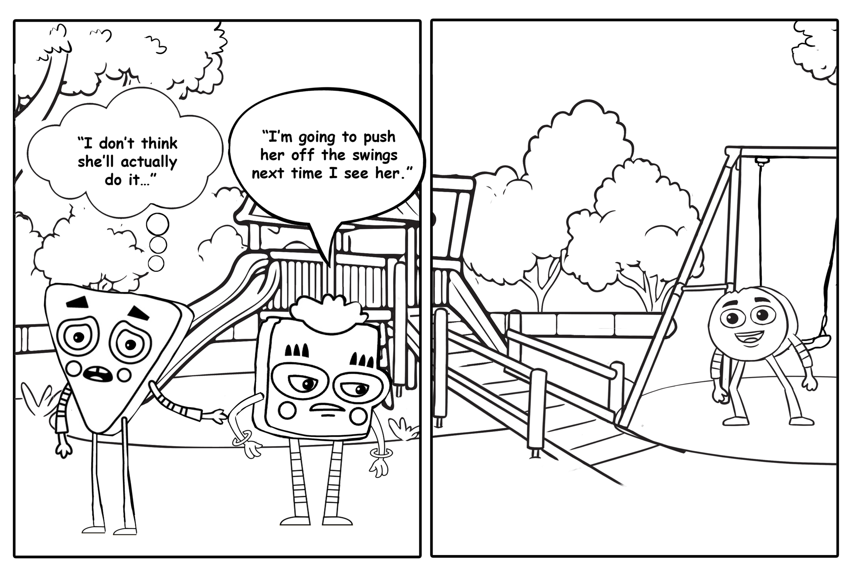
Notes:
Now let’s look at another example of Step 2.. Act immediately, Take it Seriously.
What do you notice happening here?
We can see that Jasmine is upset and planning to hurt Dot. Eliott looks uncomfortable, but we can see the thought is “I don’t think she’ll actually do it…” This can lead us to think that Eliott will not tell a Trusted Adult what he heard because he does not think Jasmine will do it. Is this Step 2 in action? In not acting immediately, you are at the playground with your friend. You hear your friend say “I’m going to push her off the swings next time I see her”. You don’t think your friend will do it, so you ignore what they say and look away.
Independent activity: You’re going to have some time to color these pages! As you are coloring, share with your classmates some more examples of acting immediately and not acting immediately.

Slide 15
A Trusted Adult!
Who do I “say something” to?
Notes:
After we see warning signs or threats, act immediately and take it seriously, the final step is to "say something"!
You can always "say something" to a Trusted Adult.
A Trusted Adult is someone who will listen to you and someone you can always rely on.
One of the ways that you can "say something" is to tell a Trusted Adult. They have the experience and knowledge to get help.
There are many ways you can "say something" to a Trusted Adult.
Some are:
Talking to them
Writing a note
Can you think of other ways to “say something”?

Slide 16
Trusted Adults
Teacher
Custodian
Counselor
Principal
Librarian
Coach
Notes:
Here are several examples of Trusted Adults. Your Trusted Adult could be your teacher, principal, school counselor, or coach. They could also be someone outside of school, your parent or guardian, babysitter, a family member, or a community leader.
It’s important that you know who your Trusted Adults are right now. This way, if you notice warning signs, you will immediately know who to go to.
Independent activity: Allow students time to identify their Trusted Adult and draw it in their training book.

Slide 17
Draw what the three steps mean to you!
Notes:
Now it’s time for you to create a story using the three stays in the Say Something program .
You can draw, or write, what every step looks like in your story.
For example,
In Step 1: I would draw a warning sign. I would draw a student pushing a student in the hallway and laughing while the other student is sad.
In Step 2: I would draw a photo of me moving quickly. I could even add a little watch to show that I need to do this fast!
In Step 3: I would draw a photo of me talking to a Trusted Adult.
And just like that, I drew a story using the three steps.
Before we start, I want to ask everybody to say the three steps with me.
Repeat after me:
Step 1: Recognize Warning signs and Threats.
Step 2: When you observe a sign or threat … Act Immediately and Take it Seriously
and Step 3: Say Something
Independent Activity: Now it’s time for you to draw the three steps.
Partner activity: When students have completed their drawings, place them into partners. Have them exchange drawings and have their partners try to tell the story in the drawings.

Slide 18
If you’re not sure if you noticed a warning sign or threat, always seek a Trusted Adult for help! Safety first always.
Notes:
Remember that even if you’re not sure, you should always seek your Trusted Adult. You have the power to help keep your school safe.

Slide 19
Teach someone else the three Say Something steps! Write the steps down today and leave them somewhere outside of your classroom so others can learn them, too.
Notes:
Before we wrap-up, we would like to leave you with a promise challenge. A Promise Challenge is an everyday way you can teach others about the Say Something program.
Your Promise Challenge is to teach somebody else the three Say Something steps. You will write down the Say Something steps and leave them somewhere at school, outside of your classroom. This way people will find them and learn about the three steps.

Slide 20
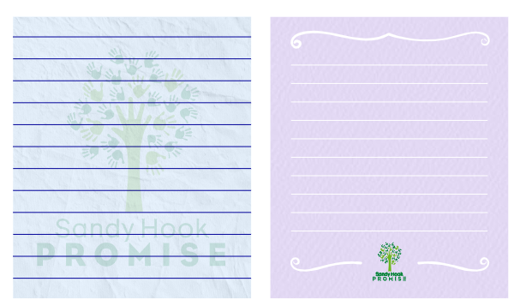
Notes:
Allow time for students to write the steps down on the note they choose.

Slide 21
I feel…
I heard...
I noticed...
I believe...

