Slide 1
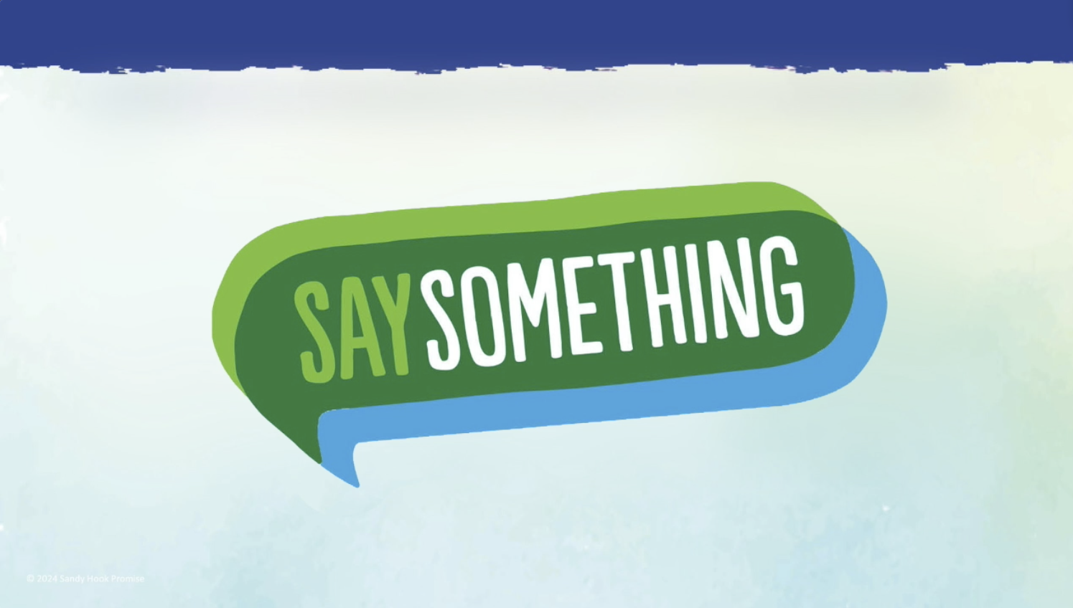
© 2022 Sandy Hook Promise
Notes:
I am going to talk with you about the Say Something program and it’s three easy steps that you can use to help keep your school safe.
Note for teachers:. Please remind students to have a paper and pen or pencil with them for my presentation, as I'll be asking your students to draw or write some things down. Students may use notebook paper, blank paper, or the handouts that Sandy Hook Promise provided to teachers earlier.
Teachers, the student activity packet with handouts is being dropped to you in the chat box if you haven't received it yet. https://sandyhookpromise.box.com/s/nvjsi3xcq4g5mjs87w5tjhu5rxzb1jws

Slide 2
This training includes discussions and images around such topics as harming others, bullying, and self-harm. This may be difficult for some students. If you are worried about any of this content now, during, or after this training, please let your teacher, counselor or another staff member know immediately.
Notes:
Before we begin, it’s important to know that this training includes topics as harming others, bullying, and self-harm. This may be difficult for some students. If you are worried about any of this content now, during, or after this training, please let your teacher, counselor or another staff member know immediately.

Slide 3
Notes:
Today, you have one goal: to learn three steps that will help you keep your friends and classmates safe from hurting themselves or someone else.

Slide 4
Someone who speaks up and takes action to create a safe community where students are included and feel a sense of belonging
Notes:
The three steps we’re about to learn will help empower you to become an Upstander and you'll hear me mention this word a few times today. So, let's review what this term means:
An Upstander is someone who speaks up and takes action to create a safe community where students are included and feel a sense of belonging.
It's important to note that we all have the power to be Upstanders.
Example story:
Imagine I am a student at (use name of your school). I enjoy making new friends and playing on the playground. I have fun and feel included when others play with me at the playground. I noticed my friends do not want to play with Malik because he is too big to fit on the slide. I know I need to be kind and play with Malik because I feel the happiest when others play with me and make me feel included. I will be an upstander by telling my friends we don’t always have to go on the slide. We can include Malik in all the other activities we play at the playground. I will be an Upstander so that my friends can learn from me and so that everyone has someone to play with today.

Slide 5
Notes:
Before we jump into the details of each step, I want to emphasize that overall schools are safe. In fact, they are one of the safest places to be in your community.
However, once in a while, there are situations where something happens that is not safe for you or classmates
That’s why I would like to introduce to you the three Say Something steps.

Slide 6
Notes:
Step 1: Recognize Warning signs and Threats.
Step 2: When you observe a sign or threat … Act Immediately and Take it Seriously
and Step 3: say something to a trusted adult. Using these three steps, you will make a real difference in keeping your school safe and getting help for people who need it

Slide 7
Notes:
Let’s look at step 1: Recognize for warning signs and threats

Slide 8
Notes:
Let’s take a moment to discuss warning signs. What is a Warning Sign?
A warning signs is a behavior that shows someone may be planning to hurt themselves or others.
Story example:
Imagine I am a student at (use school name). My best friend was always so happy and energetic. Lately, she tells me she has been having a hard time at home, her parents are always arguing. My best friend does not want to play at recess anymore and does not joke around anymore. During lunch, she used to always tell me jokes. Now she isn’t talking anymore and when she does talk all she says is “I just don’t want to do anything anymore. My parents are always fighting and I’m tired of it”. I decided to find my trusted adult and tell them what was happening because I am worried about my best friend.
Is this a warning sign?
What consequences would come from not eating at home have for my best friend?
What consequences would there be if I didn’t recognize this as a warning sign?

Slide 9
Being bullied or bullying others
Hurting yourself
on purpose
Big mood changes
Talking about
hurting others
Having access
To a gun
Saying or doing something that makes fun of others because they’re different
Hurting animals
Notes:
Here are examples of warning signs.
[The presenter reads each warning sign and goes into depth about 3-4 warning signs of their choice.]

Slide 10
Notes:
Let’s pause for an ACTIVITY. You'll need paper and a pencil or Handout #1 for this activity.
First, buddy up with another student sitting next to you. It's time to turn-n-teach to your buddy. Each student take 30 seconds to explain in THEIR OWN WORDS what a warning sign is. [After 30 seconds, prompt students to switch and have the other buddy explain what a warning sign is in their own words. Wait for a minute].
Now that you've shared your own definitions of warning signs, I'd like you to write down some warning signs you have seen before, some warning signs you may have heard before, and some warning signs that you might come across in your school and community. [Teachers, as an alternate activity, write the headings 'See, Hear, Come Across' on a white board. Ask your students to share aloud the different warning signs they've encountered and write the in the appropriate categories on the board] I’ll pause for 3 – 5 minutes for you to do this activity with your teacher.

Slide 11
Notes:
You also need to look out for threats. So, what is a threat? A threat is when a person communicates that they plan to harm themselves or others. They might say it, write it or post it.

Slide 12
“I’m going to hit him after school.”
“I think I’m going to hurt myself.”
“This school should be shot up.”
Notes:
Here are some examples of threats [trainer chooses one to go into more detail about]:
“I’m going to hit him after school.”
“I think I’m going to hurt myself”
“This school should be shot up.”

Slide 13
Notes:
For example, you may see people showing warning signs or communicating threats in the classroom, the hallways, the cafeteria, the bus, at home, at parties, and at sporting events.

Slide 14
Notes:
You are likely to find warning signs and threats on Social Media. It’s where many students go to make a threat or express their feelings, including anger, anxiety, or depression.
And someone’s post reshares and “likes” can also be a place to find potential warning signs and threats.
The adults aren’t on the same platforms you are, so they aren’t seeing everything you see. You are the eyes and ears of your school.

Slide 15
Notes:
Now that you know step one - how to recognize warning signs and threats, let’s learn about step 2: Act Immediately and Take It Seriously.

Slide 16
As soon as you SEE, HEAR, NOTICE
or READ a warning sign or threat,
and get help
Notes:
WHEN SHOULD YOU ACT? As soon as you SEE, HEAR, NOTICE or READ a warning sign or threat, act immediately and get help
Story example:
For example, Imagine if my sister is being bullied by a group of girls. She only has one friend who is nice to her, but that friend is not feeling well and hasn’t been to school. I heard my sister whispering at the playground to her friend about taking one of the guns our dad had for hunting to school. She said that she would use the gun next time one of the girls at school was mean to her. I was shocked and confused hearing this. I could never imagine my sister being so upset she would think about something like this, and I took a moment to decide what I should do next. I knew I should act immediately when I heard this. I went to search for my teacher, but she said she was a little busy right now. I told her that this could not wait, it was an emergency. She quickly sat with me and asked what was so important. I told her what I heard, and she thanked me for acting so quickly.

Slide 17
“They’re just kidding.”
“I’m sure someone else said something already.”
Notes:
What are some reasons we may not act immediately?
You may see a warning sign and think:
They're just kidding
I'm sure someone else said something already

Slide 18
Notes:
One of the biggest reasons that stops us from acting immediately is that we’re worried that if we tell on someone (or tattle), we will be called a snitch and our friends will be mad at us, call us names, and might not want to be friends anymore.

Slide 19
Trying to get someone in trouble for your own gain
Getting someone help for their own safety and protecting others from harm
Notes:
But there’s a huge difference between Saying Something and telling on someone (or tattling on someone )...or snitching.
When you snitch, you’re trying to get someone in trouble for your own gain
When you Say Something, you’re getting someone help for their own safety and protecting others from harm
Saying Something is about helping someone else.

Slide 20
Notes:
After we see warning signs or threats, act immediately and take it seriously, the final step is to say something to a Trusted Adult.

Slide 21
Notes:
One of the ways that you can Say Something is to tell a Trusted Adult. They have the experience and knowledge to get help.
A Trusted Adult is someone who will listen to you and someone you can always rely on.
Imagine I am a student at a new school. I am feeling nervous about coming to a brand-new school. As I was trying to let go of my nerves, a group of boys pushed me and laughed when I was walking in the hallway. This made me afraid they would do it again, but I ignored it. I went to my next class, and the same students pushed me. As the day went on, every time they saw me, they pushed me. Although I am new to the school, I felt afraid to go back after my first day. I knew I did not want to be afraid at school, so I searched for a trusted adult, my teacher. I told her what was happening and that I didn’t want it to happen again tomorrow. My teacher listened to me and told me she would help.

Slide 22
Teacher
Principal
School Counselor
Coach
Notes:
Here are several examples of Trusted Adults. your Trusted Adult could be your teacher, your principal, your school counselor, or your coach.

Slide 23
Parent or Guardian
Babysitter
Family Member
Community Leader
Notes:
They could also be someone outside of school, your parent or guardian, your babysitter, a family member or community leader, like a priest or pastor.
And it’s important that you know who your Trusted Adults are right now. This way, if you do see warning signs, you will know immediately who to go to.
Did I leave any other examples of Trusted Adults off this list? Who else could you consider as a Trusted Adult? Teachers, please ask your students and share any new Trusted Adult examples in the Q&A.

Slide 24
Start with "I want to say something" and tell your Trusted Adult what you are concerned about.
EXAMPLE:
“I want to say something to you about my best friend because he is being bullied and I need your help to make it stop.”
Notes:
Let’s talk about how to have a conversation with a Trusted Adult.
Start with "I want to say something" and tell your Trusted Adult what you are concerned about.
EXAMPLE:
“I want to say something to you about my best friend because he is being bullied and I need your help to make it stop.”
Now let’s watch a video about talking to a Trusted Adult.

Slide 25
Notes:
Play Video

Slide 26
​Call 911 when there is an emergency
and then tell a Trusted Adult
Notes:
Now Let’s talk about 911
You should only call 911 when there is an emergency and then tell a trusted adult.
An emergency is when someone needs help right away because they are injured or in immediate danger.
For example, of an emergency when you should call 911 first and then tell a Trusted Adult is if someone threatens to shoot people and shows you a weapon ​
If you have questions about calling 911, talk with your Trusted Adult

Slide 27
Notes:
Let’s review the three steps: step 1: Recognize warning signs and threats.
Step 2 act immediately and take these warning signs seriously
And Step 3, Say Something to a Trusted Adult, use the anonymous reporting system or call 911 in an emergency
By bringing the three steps of Say Something into our day-to-day lives, we – as students – will be able to reduce violence and threats in our schools, and make our schools and communities a better place to be. We have the power to make a difference in the world around us, just by Saying Something

Slide 28
You are the eyes and
ears of your school
Notes:
So Why should you Say Something? You are the eyes and ears of your school.

Slide 29
You are the heartbeat
of your school
Notes:
Why should you Say Something? You see and hear things others don’t. You have the power to be an upstander and say something

Slide 30
You can help keep your
school safe
Notes:
Why should you Say Something? You can help keep your school safe

Slide 31
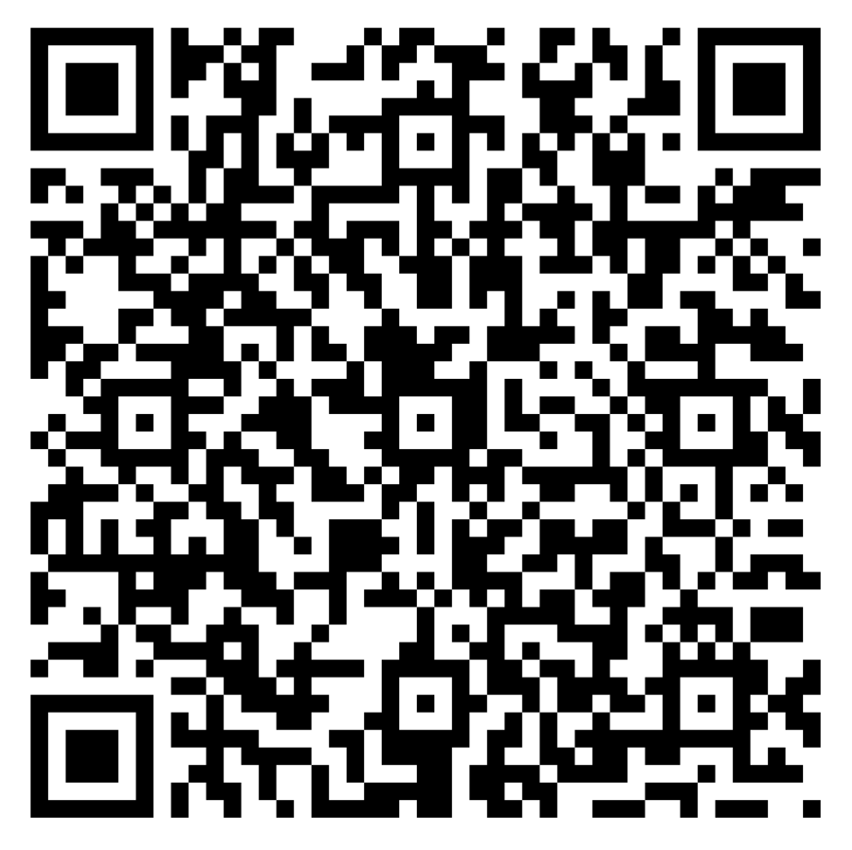
Thank you, Teachers!
Please take a moment to complete our survey.
Notes:
Teachers, we would love your feedback. Please take a moment to complete our survey using the QR code on screen. The survey should take less than 5 minutes to complete.

Slide 32
© 2022 Sandy Hook Promise
Notes:
Thank you for taking the time to learn about the Say Something program
Being a student means you are have the ability to support the community around you. Stand up for your school, your peers, and your friends, and Say Something.

